Slide 1
Protecting Your Castle:
IP & Data Security in the AI Gold Rush

Slide 2
IP Rights Implicated by AI
Copyrights
Trademarks
Design Patents
Utility Patents
Confidential & Proprietary Information

Slide 3
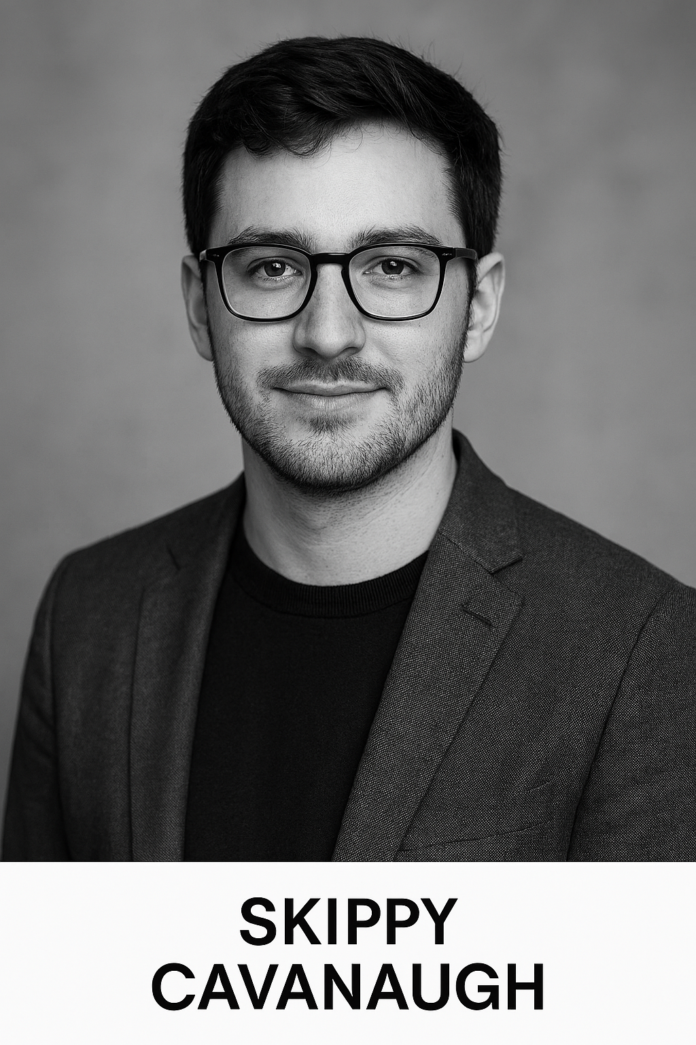
“Case Study”
Skippy Cavanaugh’s New Widget Company

Slide 4
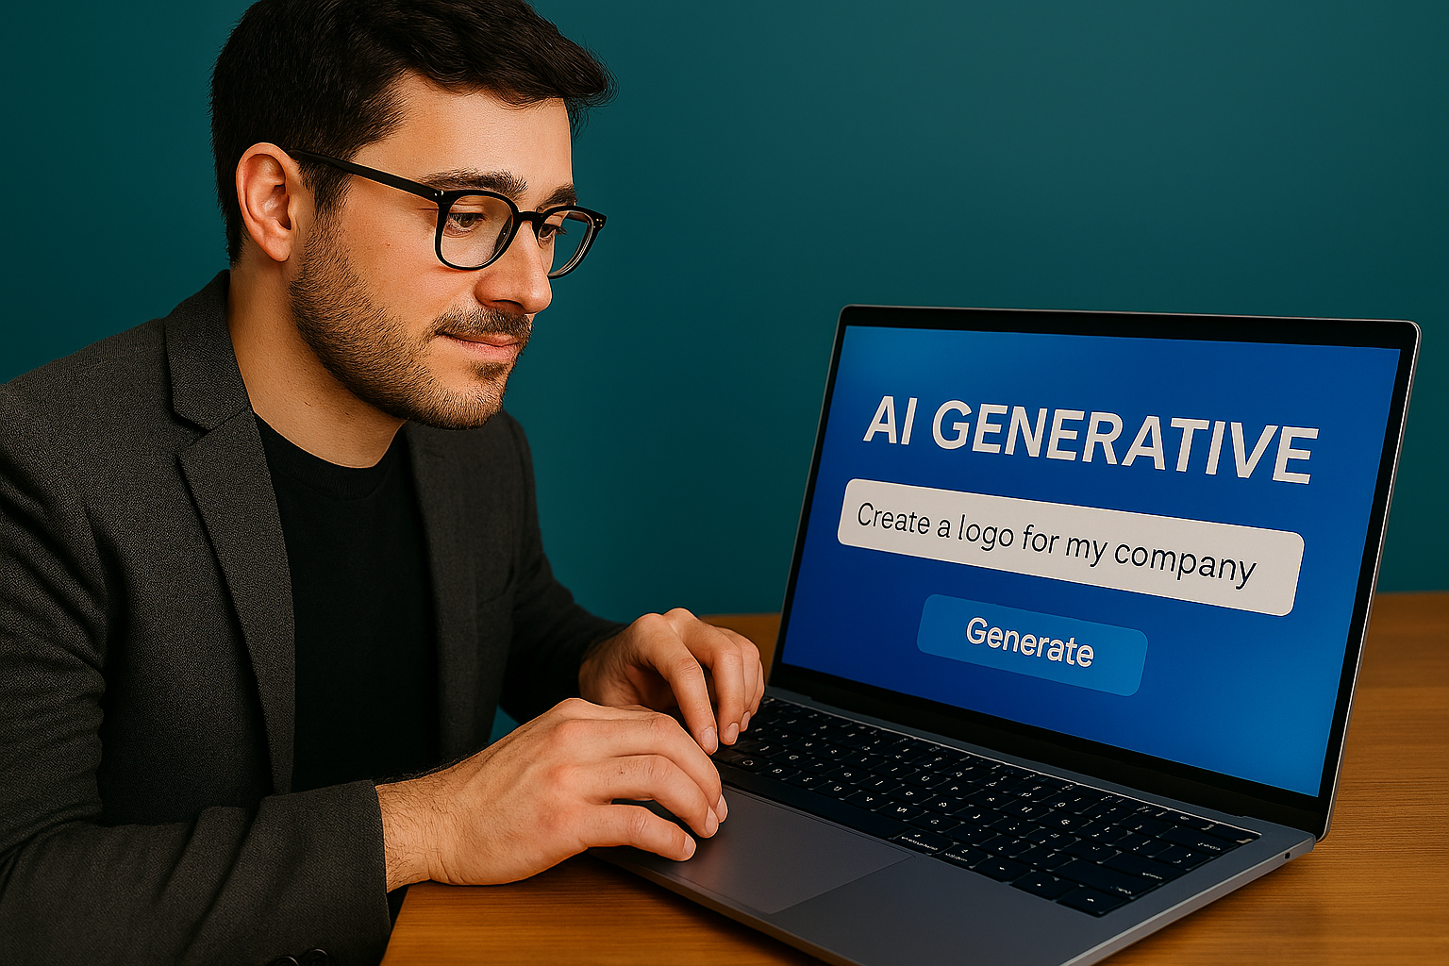
Step 1 – Skippy Chooses a Name & Logo
What Skippy Did:
Used generative AI to select his name and design a logo.
Prompted the generative AI to make the logo look like that of a well-known competitor.

Slide 5
Step 1 – Skippy Chooses a Name & Logo
How Skippy Got in Trouble:
Failed to conduct a trademark freedom to use search before using the name and logo.
  Now Skippy faces a trademark infringement suit from his competitor.
  The competitor is also threatening to sue for copyright infringement based on the artwork which forms the logo looking nearly identical to theirs.
  As part of the lawsuit, the competitor is threatening to pursue treble damages for willful infringement.
Failed to conduct a trademark registrability search before using the name and logo.
  Now the U.S. Patent & Trademark Office is refusing to register his trademarks (both for the name and logo).
  Without trademark registrations, Skippy’s products are vulnerable to counterfeiting, particularly on popular e-commerce platforms.
Notes:
Andersen v. Stability AI Ltd. – Generative AI platform included a “trade dress database that can recall and recreate the elements of artist’s trade dress.”
U.K. decision in Getty Images v. Stability AI – AI models producing images containing “Getty Images” watermarks constitutes trademark infringement.

Slide 6
Step 1 – Skippy Chooses a Name & Logo
What Skippy Should Have Done:
Prompt the generative AI to consider trademark infringement and registration concerns when choosing his name and designing his logo.
Have a trademark landscape search conducted to determine if his name and/or logo would be confusingly similar to those of a competitor.
Have a search conducted of U.S. Patent & Trademark Office records to determine if there are any obvious blocks to his ability to register his trademark.
Engage a licensed attorney to opine on infringement issues so as to avoid treble damages for willful infringement.

Slide 7
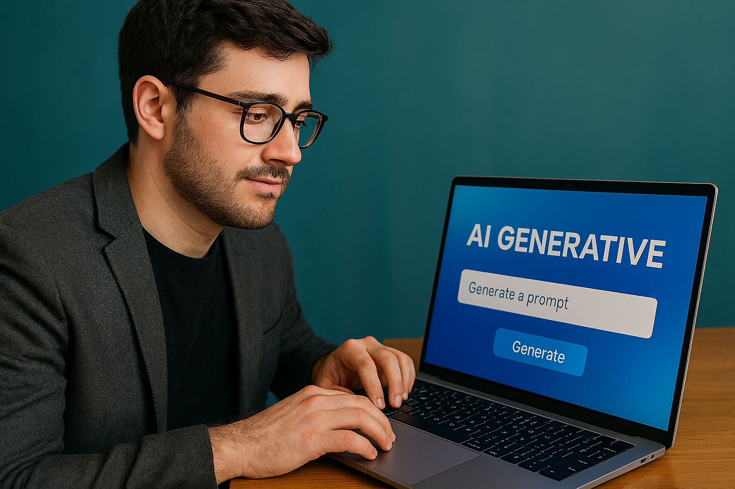
Step 2 – Skippy Designs a New Widget
What Skippy Did:
Used generative AI to design a 3D CAD model of a new widget for him to manufacture and sell.
Provided generic prompts to the AI program with little to no scientific or engineering contribution from Skippy.
Later, Skippy applied for a United States Utility Patent for the widget.

Slide 8
Step 2 – Skippy Designs a New Widget
How Skippy Got in Trouble:
Inventorship – U.S. patent law requires a human inventor to make “a significant contribution” to the claimed inventive concept. By failing to provide guidance to the generative AI program, Skippy may be left without a human inventor required to obtain patent protection over “his” widget.
Obviousness – U.S. patent law prevents patenting inventions that would have been obvious to a person having ordinary skill in the art based on the teachings of the prior art. By relying solely on generative AI for product design, the U.S. Patent and Trademark Office may reject Skippy’s patent application on the basis that the AI outputs could be easily derived by the person having ordinary skill in the art.
Deemed Export – If Skippy’s widget involves certain critical technology, his use of an AI server – which may be located in a country subject to U.S. deemed export laws – could subject Skippy to fines of up to $20,000 per day.

Slide 9
Step 2 – Skippy Designs a New Widget
What Skippy Should Have Done:
Laid out the basic design of his widget before engaging generative AI to document his human inventorship for patent purposes.
Provided specific scientific and engineering guidance in his prompts to the generative AI to further ensure his human inventorship.
Limited the use of generative AI to digitizing his already developed ideas, such as creating a 3D model of a hand sketch for his widget, to avoid future patent obviousness issues.
Ensure that the generative AI program he used utilizes is a U.S. company utilizing servers located in the U.S. to avoid deemed export liability.

Slide 10
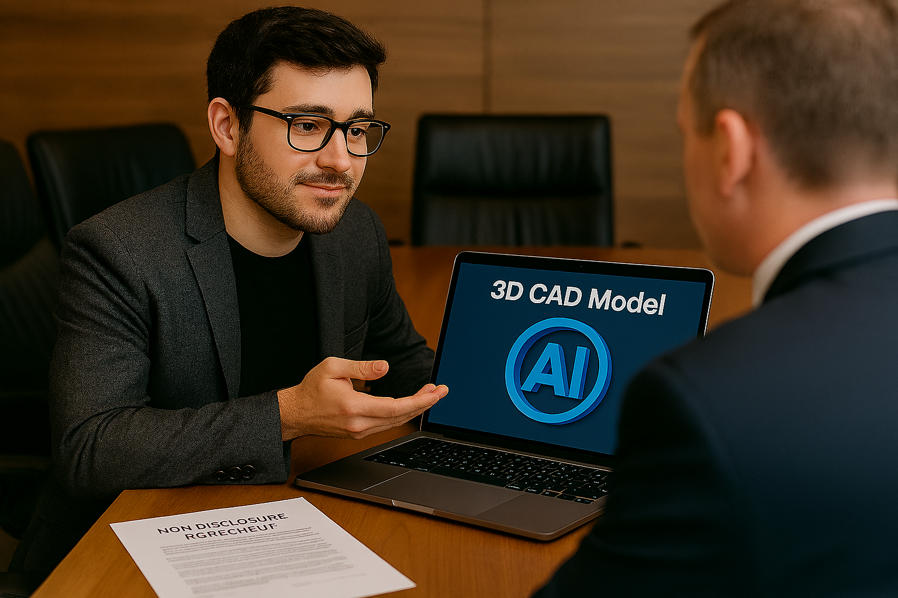
Step 3 – Skippy Contracts to Have His Widget Made
What Skippy Did:
Took his generative AI designed widget to a contract manufacture to have it prototyped.
Had generative AI produce a standard non-disclosure agreement for the contract manufacturer to sign.
Collaborated with the contract manufacturer to make improvements on the final design of his widget.

Slide 11
Step 3 – Skippy Contracts to Have His Widget Made
How Skippy Got in Trouble:
Failed to consider invention assignment in the non-disclosure agreement.
  After Skippy applies for a patent application on his widget, the contract manufacturer claims that they own an undivided co-interest in the patent application because they came up with ideas that were incorporated into the final widget and the corresponding patent claims.
  The contract manufacturer’s claim calls into question validity of Skippy’s patent application and may result in a third-party who has ownership rights in the patent that they can use to compete with Skippy.
Failed to consider trade secret implications in the non-disclosure agreement.
  Duration: Skippy’s non-disclosure agreement treats trade secrets the same as general confidential information, and the contract manufacturer is only required to keep it confidential and not use it for 2 years after the agreement terminates.
  Jurisdiction, venue, and choice of law
    North Carolina law – which Skippy used in the non-disclosure agreement – provides that trade secrets can only be stolen if they are in tangible form.
    Other states, like Ohio, provide that trade secrets can be stolen by memory as well as when they are in tangible form.

Slide 12
Step 3 – Skippy Contracts to Have His Widget Made
What Skippy Should Have Done:
Produced a non-disclosure AND invention assignment form granting Skippy’s company current ownership of all intellectual property – including patents – developed by the contract manufacturer in the process of prototyping and manufacturing Skippy’s widget.
Separated treatment of trade secret information from that of general confidential information, and included provisions that any trade secret information must be kept confidential in perpetuity (or until it is no longer a trade secret).
Ensured that the non-disclosure agreement was governed by the laws of a state that enforces trade secret protections – even when the trade secret is stolen by memory instead of in a tangible form.

Slide 13
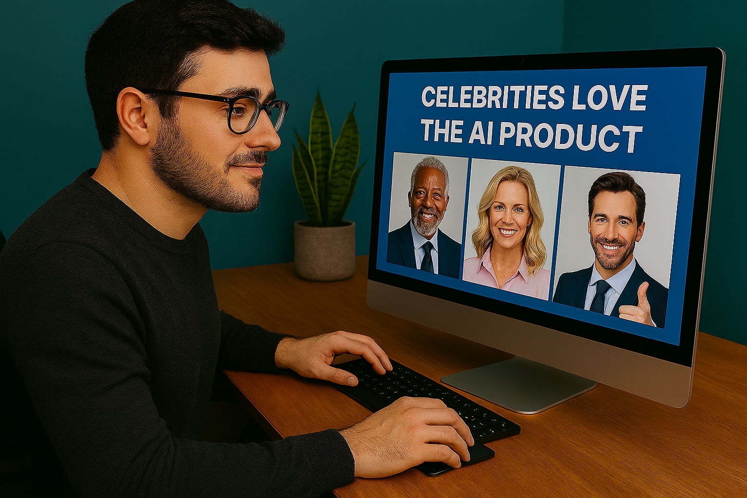
Step 4 – Skippy Produces Marketing Content
What Skippy Did:
Used generative AI to design his website, create social media posts, and draft marketing literature.
Prompted the generative AI to include images of people resembling well-known celebrities for his social media posts.
Prompted the generative AI to include background artwork on his website resembling the style of a well-known modern artist.
Wrote open-ended prompts when having the generative AI create text to accompany his marketing content.

Slide 14
Step 4 – Skippy Produces Marketing Content
How Skippy Got in Trouble:
Failed to obtain rights to the name, image, and likeness of the celebrities whose images he prompted the generative AI to include in his social media posts.
  Now Skippy faces lawsuits from different celebrities and athletes claiming that he improperly profited from their name, image, and likeness.
Failed to obtain rights to use the artists works, which the generative AI ended up copying near verbatim.
  Now Skippy faces a lawsuit from the artist alleging copyright infringement.
  Skippy could be facing statutory damages of up to $30,000 per copy of the artwork used simply for his website background.
Failed to prompt the generative AI to exclude text and images that it may have been trained on, but which are subject to federal copyright protection.
  Now Skippy faces lawsuits from several authors alleging he plagiarized their work and violated federal copyright law.
  Again, Skippy could be facing statutory damages of up to $30,000 per copy of the text found to infringe third party copyright registrations.
Notes:
Main Sequence Ltd. v. Dudesy, LLC – estate of George Carlin sued (and later settled with) a podcast company of rights of publicity violations based on AI-generated content impersonating Carlin’s voice.
2025 guidance from the U.S. Copyright Office – “Some outputs of AI programs might infringe copyrights in other works they resemble that were used to train the AI. Copyright owners may be able to establish that such outputs infringe their copyrights if the AI program both (1) had access to their works and (2) created “substantially similar” outputs.” AND “If a generative AI output infringes a copyright in an existing work, both the AI user and the AI company could potentially be liable under current law.”

Slide 15
Step 4 – Skippy Produces Marketing Content
What Skippy Should Have Done:
Prompt the generative AI to use unique images which does not resemble any known person, in particular celebrities or athletes.
Prompt the generative AI to design a unique background for his website without using any particular artistic style.
Prompt the generative AI to create unique text which is not subject to copyright protection, or which is otherwise in the public domain.

Slide 16
New Development – AI and Attorney/Client Privilege
United States v. Heppner (Federal District Court for the Southern District of New York)
Heppner – after being indicted on fraud charges – uses generative AI to create over 30 documents to support his legal defense.
U.S. Dept. of Justice seized Heppner’s electronic devices containing copies of those documents.
Heppner’s attorneys assert attorney/client privilege in an attempt to prevent the DoJ from using those documents in their case against Heppner.
February 10, 2026 ruling from the Court:
  Defendant (Heppner)’s use of generative AI to assess legal exposure not protected by attorney/client privilege, even when the documents were intended to be shared with Heppner’s attorneys for purposes of his legal defense.
  Any privilege was waived because the information was shared with and generated by a third-party AI platform.
  The third-party AI platform does not constitute Heppner’s legal counsel, nor was it used at the direction of Heppner’s legal counsel, and therefore attorney/client privilege does not attach.

Slide 17
QUESTIONS?

